Slide 1
Modelleren en Systeemontwerp
Requirements engineering

Slide 2
Development process: Requirements engineering
Requirements Engineering aims to describe what the system should do, allowing customers and developers to agree on that description.

Slide 3
Requirements – why?
Software errors cost the American economy about $60 billion each year
84% of all software projects are unsuccessful (late, over budget, cancelled, etc.)
Three of the top reasons for failure:
Poor user input 13%
Incomplete requirements 12%
Changing requirements 7%
Requirements are really important!

Slide 4
Stakeholders and concerns
Requirements should identify relevant stakeholders and concerns
A stakeholder is a person, group, or entity with an interest in or concerns about the realization of the architecture
A concern is a requirement, an objective, an intention, or an aspiration a stakeholder has for that system

Slide 5
Requirements - definition
A requirement is a feature that a system must have or a constraint it must satisfy to be accepted by the client
Requirements engineering is the process of identifying and defining the requirements of a software system
Requirements engineering is a cyclic process:
Elicitation
Specification (e.g. use cases, scenarios)
Validation and verification
Negotiation

Slide 6
Requirements examples
Requirements come in all kinds of shapes and sizes:
Functional: features, capabilities
Usability: help, documentation
Reliability: frequency of failure, uptime, recoverability
Performance: response time, accuracy, throughput
Supportability: adaptability, maintainability
But also sub-factors such as:
Implementation: languages and tools, hardware
Legal: licensing
Interface: constraints arising from other systems

Slide 7
Requirements – how?
Many customers have little technical skill. Or they may not even know what they want themselves. How can you figure out what they want?
Eliciting clear requirements is not as easy as you may think…
(Example from O'Reilly's Head First Object-Oriented Analysis and Design)

Slide 8
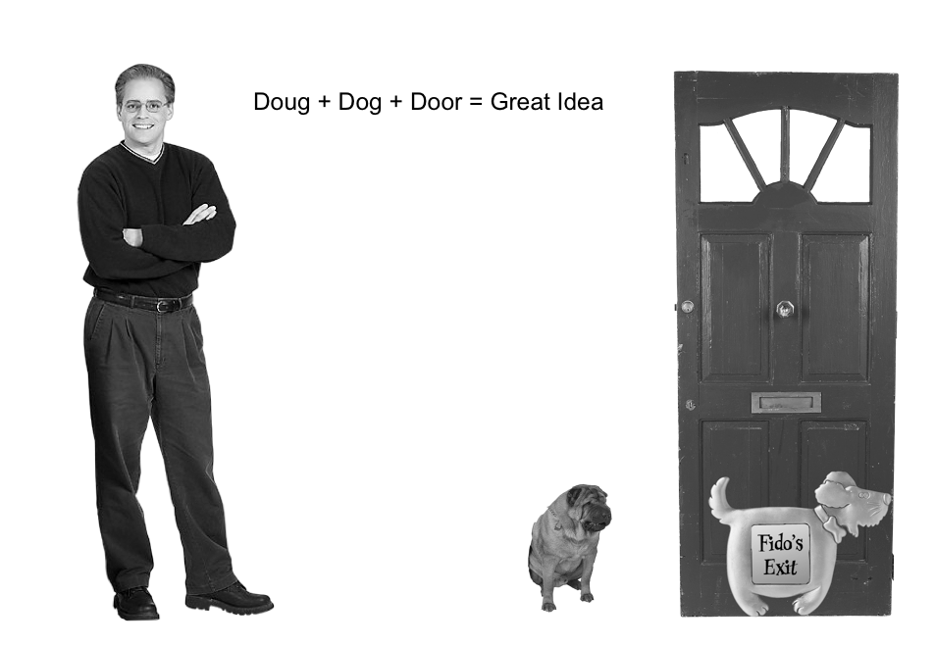

Slide 9
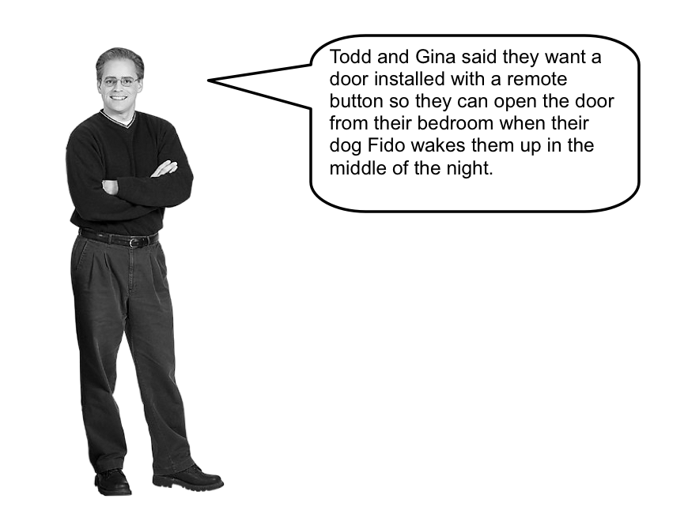

Slide 10
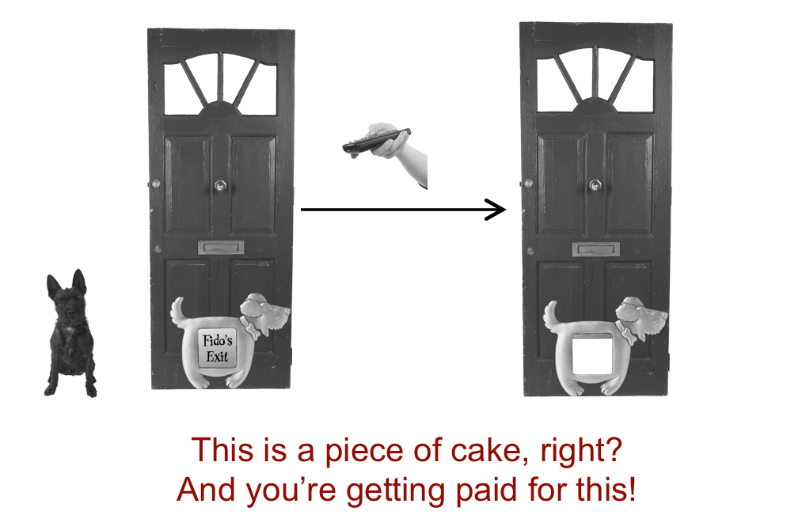

Slide 11
Easy spec
Push the button on the remote to open the door
Push the button on the remote to close the door

Slide 12
Initial design
DogDoor class
method Open
method Close
method WaitForRemote
Remote class
tell the DogDoor to open and close
knows when the button is pressed.

Slide 13
public class DogDoor {
private boolean open;
public DogDoor() {
this.open = false;
}
public void open() {
Console.WriteLine("The dog door opens.");
open = true;
}
public void close() {
Console.WriteLine("The dog door closes.");
open = false;
}
public boolean isOpen() {
return open;
}
}

Slide 14
public class Remote {
private DogDoor door;
public Remote(DogDoor d)
{ ... }
public pressButton () {
if (door.isOpen()) {
door.close();
} else {
door.open();
}
}
}

Slide 15
What else?
This defines the core class files
(I'm ignoring the interface to the door's hardware)
Perhaps we should write some tests?

Slide 16
public class DogDoorSimulator {
public static void main(String[] args) {
DogDoor door = new DogDoor();
Remote remote = new Remote(door);
Console.WriteLine("Fido barks to go out.");
remote.pressButton();
Console.WriteLine("Fido has gone.");
remote.pressButton();
Console.WriteLine("Fido's all done.");
remote.pressButton();
Console.WriteLine("Fido's back inside.");
remote.pressButton();
}
}

Slide 17
So we’re done!
We have talked to our customer to establish some requirements
We have implemented a system that satisfies these requirements
We have tested that our system behaves as expected

Slide 18
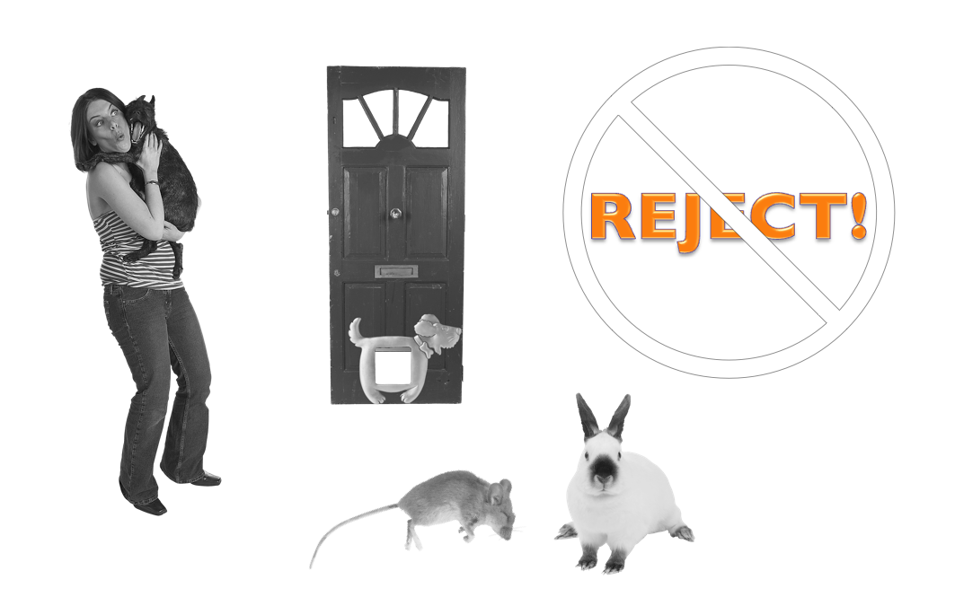

Slide 19
What went wrong?
We implemented what we were asked
The hardware works
The software works
Our test suite passes
Getting the requirements right is not just the customer’s responsibility!

Slide 20
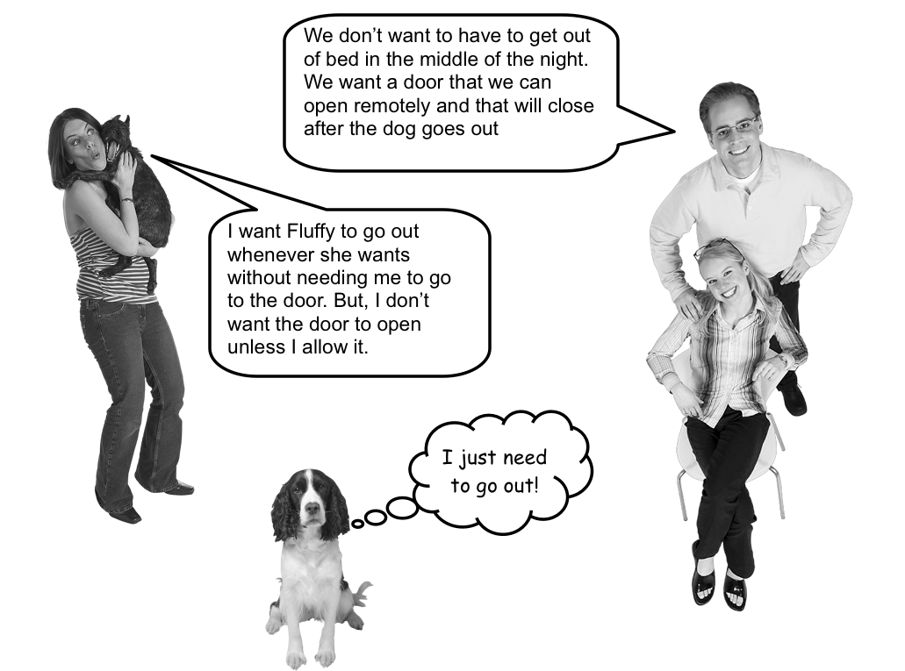

Slide 21
But what if…
Question: what else could possibly go wrong?

Slide 22
But what if…
Fido does not bark to go outside?
Todd and Gina don't hear Fido barking?
Fido is barking, but does not want to go outside?
the door is closed before Fido returns?
the door jams?
the door closes as Fido is going outside?
. . .

Slide 23
Why this example is important
The implementation of the DogDoor is super simple - it is essentially a single boolean
But figuring out what the customers want is really hard!
How can we figure out what the customer wants?

Slide 24
Finding requirements
Elicitation
talk to clients and end-users
gather existing documentation
observe how future users work now
But be careful:
`Customers can check bank balances’ - but only their own!
`A grade above 6.0 is a pass’ - but so is a 6.0!
`Every telephone number starts with an area code’ - unless it’s for a cell phone

Slide 25
Inception – what it is and what it isn’t
It's not about identifying every possible interaction that every imaginable user can have with your system
You want to have an idea of which people will end up using the system
You should have a few carefully thought out use cases

Slide 26
Elicitation techniques - I
Asking:
What do you expect from the system?
Interview, brainstorm, questionnaire, . . .
Task analysis:
Which subtasks can you identify?
How can you organize tasks into a hierarchy?

Slide 27
Elicitation techniques - II
Scenario-based analysis
How do you do Y?
But what happens if . . . ?
Ethnography
Actively observing users do their work
May be more reliable than asking them

Slide 28
Elicitation techniques - III
Analyzing existing documents and systems
What problems do the existing systems have?
Prototyping - is this what you had in mind?
Domain analysis - how are other systems in this domain built?

Slide 29
What makes a good set of requirements?
Correctness: it accurately captures the client's views
Consistency: it does not contradict other requirements
Completeness: all possible scenarios are accounted for
Clarity: unambiguously formulated
Realism: it can be implemented and delivered
Verifiability: it can be (automatically) tested

Slide 30
Examples of poor requirements
The system should be usable by elderly people
Not verifiable and unclear
Better: All text should be in at least 14pt font
Upon completion, the final product shall not have any errors
Not verifiable and not realistic
Better: give specific test criteria
The product shall respond rapidly
Not verifiable and unclear
Better: The system shall respond in less than 2s
Best: The system shall respond in less than 2s in 99% of the cases

Slide 31
Not all requirements are created equally
Everyone wants a system that is up 24/7, is easy to take down for maintenance, cheap to implement, immediately responsive, and that looks pretty
Trying to identify what is really important can save you a lot of development time down the road

Slide 32
Requirements are not a wish list
In the Software Project that CS students do in to complete their BSc, many students make the same mistake:
Requirements are not a wish list
Requirements are a contract for the minimal functionality that you can promise to deliver

Slide 33
Try different techniques
The more information you have...
the better you understand the domain,
the better you can write and prioritize your scenarios,
the greater the chance of success.

Slide 34
Development process: Scenarios and use cases
One of the most popular way to establish (functional) requirements is through writing scenarios and use cases
These document the system's behavior from the user’s point of view, in a way that customers can understand what the system does - how does the system add value to the user?
Use cases and scenarios are crucial if you want to agree on what the system does

Slide 35
Scenarios: definition
A narrative description of what people do and experience as they try to make use of computer systems and applications - (M. Carroll, 1995)

Slide 36
Scenario: example
Alice goes to the cash machine
She enters her card and PIN
She requests to see her bank balance and withdraws 20 euros
She takes her money, card and a printed receipt
Note that:
This only describes a single transaction - it does not capture all possible interactions or all possible outcomes
The actors involved may be people, systems, or even organizations

Slide 37
Use cases - definition
A use case is more general than a scenario. It documents an interaction between users and the system that yields an observable result or value.
When writing use cases, many authors distinguish different levels:
Brief - a one paragraph summary of the main success scenario
Casual - a few paragraphs that cover various scenarios
Fully dressed - a detailed account of all possible steps and variations, including entry conditions, exit conditions and special requirements

Slide 38
Use cases: brief
Bank Customers should be able to go to the ATM and withdraw money from their account. To do so successfully, they start by identifying themselves using their bank card and PIN.
After selecting the account from which they wish to withdraw money, the necessary information is transmitted to the bank.
Once the bank verifies that there is sufficient money in the account, the money is dispensed, together with the bank card and a receipt.

Slide 39
Use cases: casual
Give a brief account of several different scenarios:
What if the PIN number is wrong?
What if the ATM is out of money? Or cannot dispense the requested amount?
What if the user does not have enough money on his account?
. . .

Slide 40
What to write?
A fully dressed use case consists of:
A unique name
Participating actors
Entry conditions
Flow of events
Exit conditions
Special requirements
This general format was originally suggested by Alistair Cockburn and is used throughout Larman's Applying UML and Patterns.

Slide 41
Example: withdrawing money
Brief Description
This use case describes how the Bank Customer uses the ATM to withdraw money to his/her bank account
Actors
Bank Customer and Bank
Entry conditions
There is an active network connection to the Bank
The ATM has cash available

Slide 42
Example – “Happy flow”
Bank Customer inserts their Bank Card
Use Case: Validate User is performed
The ATM displays the different alternatives that are available on this unit; in this case the Bank Customer always selects “Withdraw Cash"
Card ID, PIN, amount and account are sent to Bank as a transaction; the Bank Consortium replies with a go/no go reply telling if the transaction is ok
The Bank Card is returned
The money is dispensed
The receipt is printed
The use case ends successfully

Slide 43
Alternative flows
Invalid User
If in step 2 of the basic ow Bank Customer the use case: Validate User does not complete successfully, then:
The use case ends with a failure condition
Insufficient cash
If in step 5 in the basic ow, the Bank Customer enters an amount that exceeds the amount of cash available in the ATM, then
The ATM will display a warning message, and ask the Bank Customer to reenter a lower amount
The use case resumes at step 5

Slide 44
Alternative flows
No response from Bank
If in step 6 of the basic there is no response from the Bank within 3 seconds, then
The ATM will re-try, up to three times
If there is still no response from the Bank, the ATM shall display the message “Network unavailable - try again later"
The ATM shall return the card
The ATM shall indicate that it is “Closed"
The use case ends with a failure condition
. . . and lots more can go wrong

Slide 45
Exit conditions
Post-conditions
Successful Completion
The user has received their cash and the internal logs have been updated
Failure Condition
The logs have been updated accordingly
Special Requirements
[SpReq:WC-1] The ATM shall support localizations for all major European languages.
[SpReq:WC-2] The ATM shall keep a log, including date and time, of all complete and incomplete transactions with the Bank

Slide 46
Use cases - advice
Don't think about implementation or user interfaces
Do think about user experience
Keep the writing as simple as possible - you're not writing a novel or academic textbook, but a piece of text that should be as unambiguous as possible

Slide 47
Use cases - diagrams
Sometimes it can be useful to visualize which actors interact during certain use cases
In that case, it can help to draw UML use case diagrams

Slide 48
UML Use case example

Slide 50
Elements of UML Use case diagrams

Slide 51
Diagrams
Actors may be users, other stakeholders, or even software systems
You may want to organize actors or use cases into system boxes
You can re-use use cases using the <<uses>> arrows – for instance, both cash withdrawal and changing your PIN code require some form of authentication
You may want to identify special cases of a given use case, using <<extends>> arrows - for example, to distinguish Assign Window Seat and Assign Aisle Seat are both extensions of the Assign Seat use case

Slide 53
Detailed view

Slide 54
Requirement verification and validation
Requirements validation is concerned with checking the requirements document for consistency, completeness, and accuracy
Requirements verification is a mathematical analysis, possibly automated, of formal specifications for consistency

Slide 55
Techniques
You need to interact with users and customers to validate your requirements
Reviews, checklists, discussion
Prototypes
Animations

Slide 56
Requirements negotiation
Usually, there are constraints that limit the functionality that can be delivered (time, money, resources) . . .
. . . or there are conflicting views on requirements between different stakeholders
To establish a sensible set of requirements requires negotiation with your customer

Slide 57
Back to UP – example planning
Inception
start with a two day workshop with all stakeholders aimed at making an inventory of use cases, and writing a brief description of each one
Elaboration (first iteration)
work out key use cases in greater detail and discuss these with the client
design high-risk architectural components
start implementation
As iterations proceed, more use cases are developed, together with the prototype system. There are regular checks with the customer to check that they agree with existing requirements and the prototype system.

Slide 58
Epilog
How can I manage the process of constructing complex software?
Use the Rational Unified Process, or any other software development process
How do I know what the customer wants?
Write use cases and requirements documents

Slide 59
UP versus Agile
The Agile Manifesto
"We are uncovering better ways of developing software by doing it and helping others do it. Through this work we have come to value:"
Individuals and interactions over processes and tools
Working software over comprehensive documentation
Customer collaboration over contract negotiation
Responding to change over following a plan

Slide 60
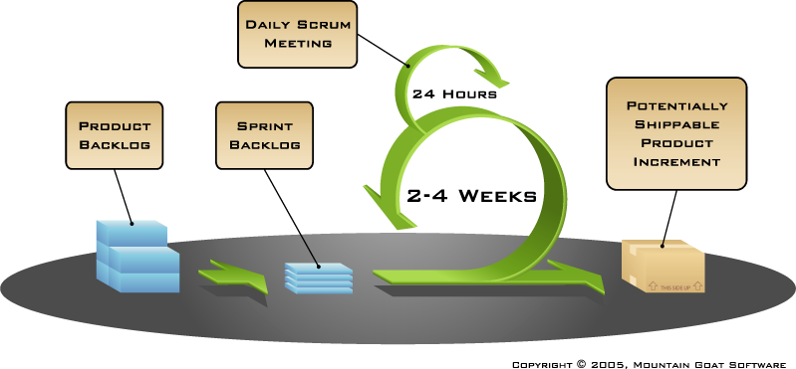
Agile software development with scrum

Slide 61
UP vs Agile
UP is an iterative top down approach
The aim of UP is to minimize change by carefully thinking about requirements and design before implementing anything
Agile is an iterative top down, bottom up approach
The aim of Agile is to minimize work for developers, by releasing prototypes quickly and involving the users in each iteration

Slide 62
Material covered
Rational Unified Process Whitepaper - available on the MSO website
Craig Larman. Applying UML and Patterns. Pearson Education. 2002. Chapters 1-7

